Slide 1
Course instructor
Dr. Ditipriya Sinha
C.S.E Department, NIT Patna

Slide 2
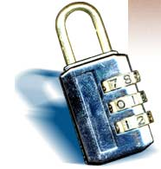
What is “Security”
Dictionary.com says:
1. Freedom from risk or danger; safety.
2. Freedom from doubt, anxiety, or fear; confidence.
3. Something that gives or assures safety, as:
1. A group or department of private guards: Call building security if a visitor acts suspicious.
2. Measures adopted by a government to prevent attack.
3. Measures adopted, as by a business or homeowner, to prevent a crime such as burglary or assault: Security was lax at the firm's smaller plant.
…etc.

Slide 3
What Does it Mean- “Security”?
Communications security - concerned with the protection of an organization’s communications media, technology, and content.
Network security is the protection of networking components, connections, and contents.
Information Security – protection of information and its critical elements, including the systems and hardware that use, store, or transmit that information.

Slide 4
What Does it Mean- “Security”?
“Security” is the quality or state of being secure--to be free from danger. But what are the types of security we have to be concern with ?
Physical security - addresses the issues necessary to protect the physical items, objects or areas of an organization from unauthorized access and misuse.
Personal security - addresses the protection of the individual or group of individuals who are authorized to access the organization and its operations.
Operations security- protection of the details of a particular operation or series of activities.

Slide 5
Figure 5
Hardware
Software
People
Procedures
Data
Components of an Information System

Slide 6
Figure 6
Internet
Computer as Subject of Crime
Computer as Object of Crime
Remote System
Hacker

Slide 7
Access vs. Security
Security Access
Balancing Security and Access- Too much security might make access hard to get and people will stop using the system. On the other hand, a too easy access protocol, might be a security hole for the network. A balance must be achieved between those two major “players”

Slide 8
Security
Data Security: “for your eyes only” Encryption, Digests, Signatures, ...
System Security: “Nothing bad happens to my computers and equipment” virus, trojan-horse, logic/time-bombs, ...
Network Security: Authentication Mechanisms “you are who you say you are” Access Control Firewalls, Proxies “who can do what”

Slide 9
Terminologies -- Concerns
Vulnerability
An inherent weakness in the design, configuration, or implementation of a network or system that renders it susceptible to a threat
Threat
Anything that can disrupt the operation, functioning, integrity, or availability of a network or system
Threats exploit vulnerabilities
Threats may be internal or external
Security Concern
Each threat-vulnerability pair represents a security concern

Slide 10

What is A Blockchain
A decentralized computation and information sharing platform that enables multiple authoritative domains, who do not trust other, to cooperate, coordinate in a rational decision making process.

Slide 11



Traditional sharing
Microsoft word to Google Doc – Sharing Information

Slide 12
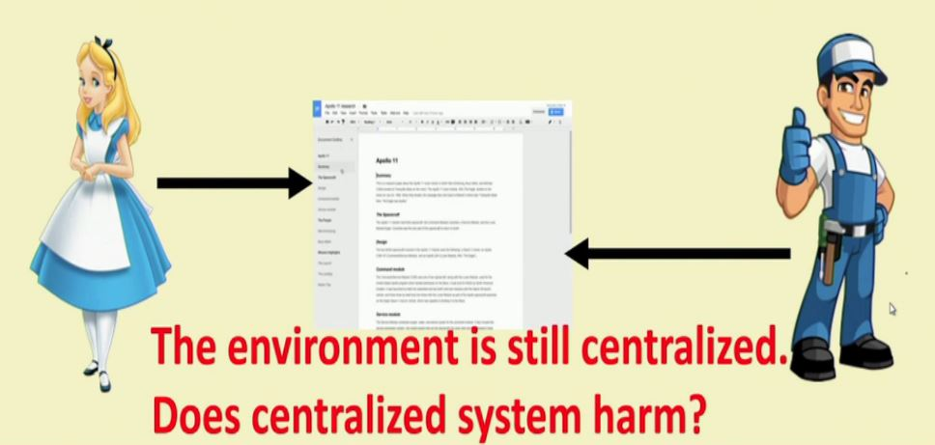
Contd.
Microsoft Word to Google Doc – Sharing Information
Shared Google doc – both users can edit simultaneously
The environment is still centralized.

Slide 13
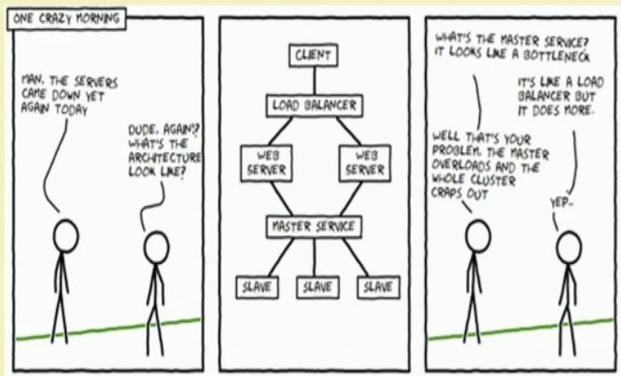
Problems with a centralized System
A single point of failure
If you do not have sufficient bandwidth to load Google doc, you’ll not be able to edit
- What if the server crashes?

Slide 14
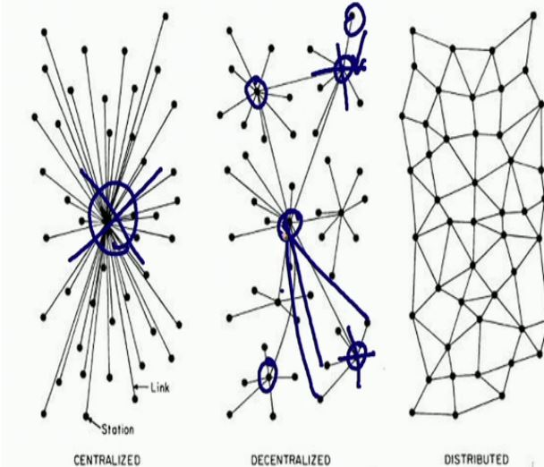
Centralized vs Decentralized vs Distributed
Complete reliance on single point (centralized) is not safe
Decentralized: Multiple points of coordination
Distributed: Everyone collectively execute the job

Slide 15
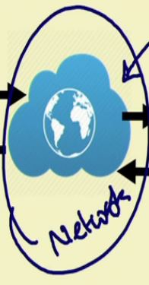
A Plausibly Ideal Solution
Alice Bob

Slide 16
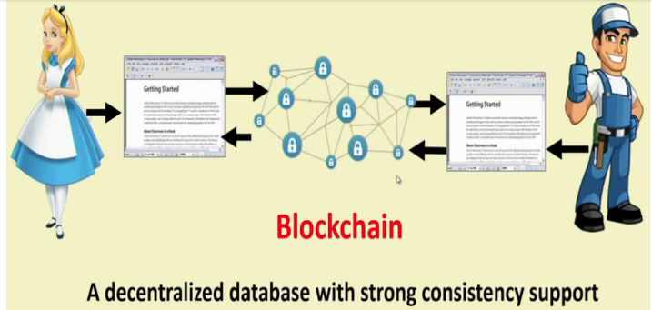
Blockchain – The Internet Database of Support Decentralization
Block Chain

Slide 17
Blockchain Technology
In recent years, a new technology of decentralized systems emerged known as Blockchain.
A Blockchain can be defined as a distributed ledger, where data can be stored in a secure manner so that, the alteration or modification of data is not possible.
On the basic level, Blockchain uses “Asymmetric Cryptography” and “Distributed Consensus Algorithms”.
Notes:
Asymmetric cryptography
Consensus algorithm

Slide 18
Cont.
Basic structure of Block of blockchain :-
A structure of public ledger
Version
Current block hash
Merkle Root
(Hash of block N-3)
Nonce
Timestamp
Difficulty target
Version
Current block hash
Merkle Root
(Hash of block N-2)
Nonce
Timestamp
Difficulty target
Version
Current block hash
Merkle Root
(Hash of block N-1)
Nonce
Timestamp
Difficulty target
Txn1, Txn2, .............., Txn n-1, Txn n
Txn1, Txn2, .............., Txn n-1, Txn n
Txn1, Txn2, .............., Txn n-1, Txn n
Block N-2
Block N-1
Block N
Notes:
Transaction defination

Slide 19
Blockchain Operation
The following operations are required to add a new information/transaction to the Blockchain:
The new transaction is merged with other stored transactions of the Blockchain and forms a new block.
Miners verify the merged transactions of the new block with respect to the defined rules.
A consensus mechanism is performed by the Miners to validate the added block.
The Miners that are involved in validating the block will be rewarded.
Verified transactions (grouped into a block) are added in the Blockchain.
Notes:
Two types of participating nodes take the responsibility of block chain operations: i) Passive Nodes and ii) Active nodes or Miners. Passive nodes are only eligible to read the stored information of a block, whereas Active nodes, also called Miners, can read and write the information of the block.

Slide 21
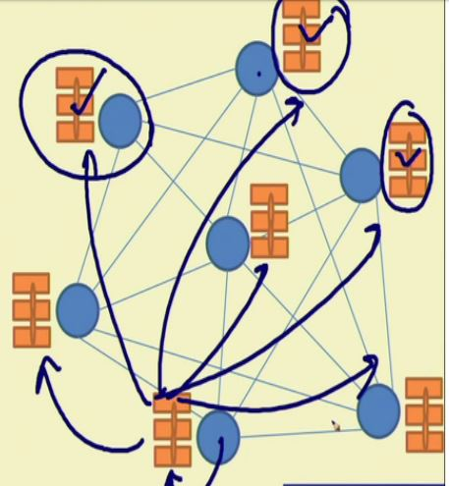
A Very Simplified Look of the Blockchain
Every node maintains a local copy of the global data-sheet
The system ensures consistency among the local copies
The local copies at every node is identical
- The local copies are always updated based on the global information

Slide 22
A Very Simplified Look of the Blockchain
We call this Public Ledger
- A database of ‘historical information’ may be utilized for future computation
An Example:
Say the historical information are the banking transactions
- The old transactions are used to validate the new transactions

Slide 24
Components of Blockchain
Node: Electronic device connected to the internet
1.Full Node: Full copy of transaction
2. Partial Node: Partial copy of ledger
Ledger: Digital database. Immutable, Distributed, Decentralised.
Wallet: Digital wallet manage cryptocurrency.
1. Privacy, 2. Secured Transaction, 3.Ease of Usage, 4. Currency Conversion

Slide 25
Nonce: Randomly generated number.
Hash: Data of any size , perform hash opertation and returns fixed size
Mining and Consensus Protocol

Slide 26



An Example of Public ledger in banking system
Public ledger of Alice
Public ledger of Bob
Alice 100 Rs
Alice 100 Rs
Public ledger of Eva
Public ledger of Jane
Alice 100 Rs
Alice 100 Rs

Slide 27
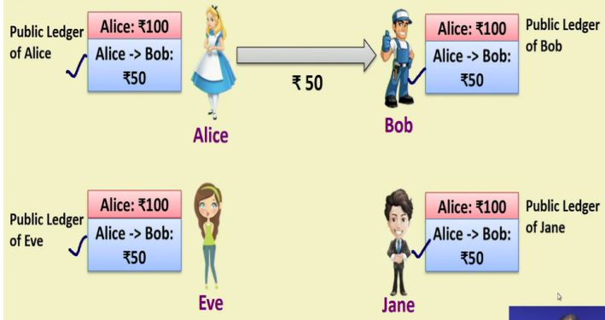
An Example of Public ledger in banking system

Slide 28
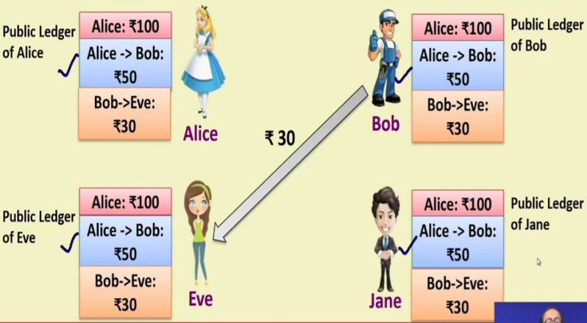
An Example of Public ledger in banking system

Slide 29
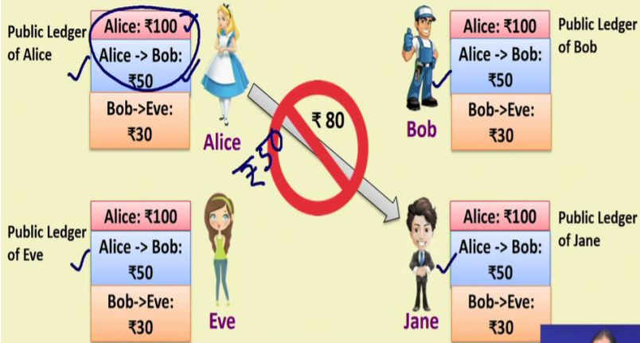
An Example of Public ledger in banking system

Slide 30
Blockchain and Public ledgers
Blockchains work like a public ledger
However, we need to ensure a number of different aspects
- Protocols for Commitment: Ensure that every valid transaction from the clients are committed and included in the blockchain within a finite time.
Consensus: Ensure that the local copies are consistent and updated.
- Security: The data needs to be tamper proof. Note that the clients may act maliciously or can be compromised.
- Privacy and Authenticity: The data(or transactions) belong to various clients; privacy and authenticity needs to be ensured.

Slide 31
Formal Defination of Blockchain
A Blockchain is an open distributed ledger that can record transactions between two parties efficiently and in a verifiable and permanent way
Keywords
Open(accessible to all)
Distributed or Decentralized(No single party control)
Efficient(fast and scalable)
Verifiable(everyone can check the validity and information)
Permanent(the information is persistent)

Slide 32
Blockchain Layer
Presentation Layer
Application Layer
Blockchain Layer
Internet Layer

Slide 33
Presentation Layer: Give access to whole network and blockchain applications. Laptops, Smartphones, Tablets
Application Layer: Combine business logic with user interaction. Dapps sets communication between presentation and blockchainlayer. Smart contrats .
Blockchain Layer: Consensus algorithm, P2P broadcast, Mining Nodes, Tokens, Distributed Ledger.

Slide 34
Internet Layer: All nodes are communicated with each other.

Slide 35
Cryptography
can characterize by:
type of encryption operations used
substitution / transposition / product
number of keys used
single-key or private / two-key or public
way in which plaintext is processed
block / stream

Slide 36
Cryptographic Algorithms
Public key encryption
- RSA, Diffie-Hellman
Bulk data encryption
- DES, 3DES, RC4, RC2, IDEA
Digital signatures
- RSA, DSS
1- Way Hash
- MD5, SHA

Slide 37
Symmetric Encryption
or conventional / private-key / single-key
sender and recipient share a common key
all classical encryption algorithms are private-key
was only type prior to invention of public-key in 1970’s
Notes:
All traditional schemes are symmetric / single key / private-key encryption algorithms, with a single key, used for both encryption and decryption, since both sender and receiver are equivalent, either can encrypt or decrypt messages using that common key.

Slide 38
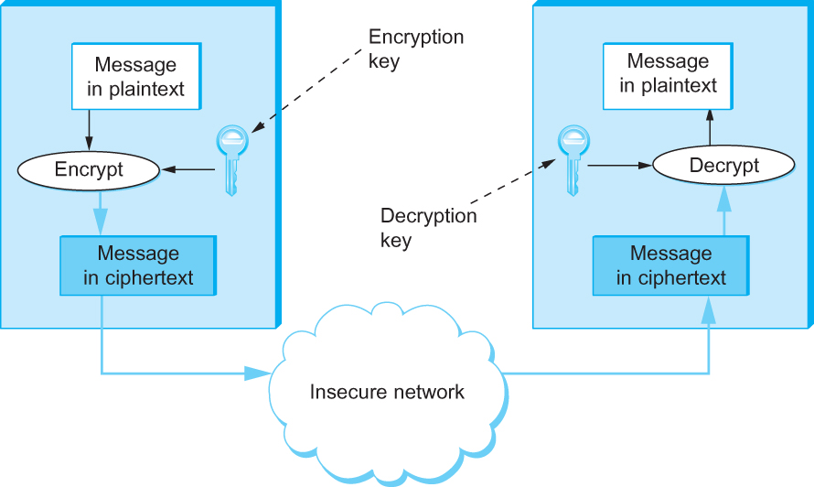
Cryptograhic Building Blocks
Symmetric-key encryption and decryption
Notes:
Restating the goals of an encryption algorithm: it should turn plaintext into ciphertext in such a way that only the holder of the decryption key can recover the plaintext. It is not a good idea to rely on the security of the algorithm, since if the algorithm is divulged or successfully attacked, the entire system, along with any stored past messages, is exposed. The longer an algorithm is in use without successful attacks is a measure of it’s security so there is a risk on relying on new algorithms when an old one is divulged. It is better to use a public, well documented algorithm with known resistance to attacks and develop a secure method to distribute keys. If the attacker has some sample part of the plaintext the task may be easier so strong encryption implies resistance to attacks even if the attacker has some, (or even all) of a plaintext message. This is because a key obtained from getting one good plaintext/ciphertext pair would compromise all previous and future messages sent with that key. The approach of DES (The government sponsored encryption specification) was to make the algorithm so complicated that little of the plaintext structure remains in the ciphertext. Since only a key search will be effective in this case, using a long private key string will make this computationally expensive.

Slide 39
Basic Terminology
plaintext - the original message
ciphertext - the coded message
cipher - algorithm for transforming plaintext to ciphertext
key - info used in cipher known only to sender/receiver
encipher (encrypt) - converting plaintext to ciphertext
decipher (decrypt) - recovering ciphertext from plaintext
cryptography - study of encryption principles/methods
cryptanalysis (codebreaking) - the study of principles/ methods of deciphering ciphertext without knowing key
cryptology - the field of both cryptography and cryptanalysis
Notes:
Briefly review some terminology used throughout the course.

Slide 40
Requirements
two requirements for secure use of symmetric encryption:
a strong encryption algorithm
a secret key known only to sender / receiver
Y = E_{K}(X)
X = D_{K}(Y)
assume encryption algorithm is known
implies a secure channel to distribute key
Notes:
Generally assume that the algorithm is known.
This allows easy distribution of s/w and h/w implementations.
Hence assume just keeping key secret is sufficient to secure encrypted messages.
Have plaintext X, ciphertext Y, key K, encryption alg Ek, decryption alg Dk.

Slide 41
Types of Cryptanalytic Attacks
ciphertext only
only know algorithm / ciphertext, statistical, can identify plaintext
known plaintext
know/suspect plaintext & ciphertext to attack cipher
chosen plaintext
select plaintext and obtain ciphertext to attack cipher
chosen ciphertext
select ciphertext and obtain plaintext to attack cipher
chosen text
select either plaintext or ciphertext to en/decrypt to attack cipher

Slide 42
Data Encryption Standard (DES)
most widely used block cipher in world
adopted in 1977 by NBS (now NIST)
as FIPS PUB 46
encrypts 64-bit data using 56-bit key
has widespread use
has been considerable controversy over its security

Slide 43
Cryptograhic Building Blocks
64-bit key (56-bits + 8-bit parity)
16 rounds
Symmetric Key Ciphers
The U.S. National Institute of Standards and Technology (NIST) has issued standards for a series of symmetric-key ciphers.
Data Encryption Standard (DES) was the first, and it has stood the test of time in that no cryptanalytic attack better than brute force search has been discovered.
Brute force search, however, has gotten faster. DES’s keys (56 independent bits) are now too small given current processor speeds.
Initial permutation
Round 1
Round 2
56-bit
key
…
Round 16
Final permutation
Notes:
It is typical for this algorithm to be implemented in hardware for speed. There is a detailed description in the text that is only slightly less confusing than the algorithm itself but briefly: each block of bits is permuted using a pattern. The bits and the key go through 16 rounds of a complicated function using bits from the message and bits from the key. The message block and the key are cut in half. Each half goes through a set number of rotations or shifts. After the 16 rounds of encryption, the block is then put through a reverse of the permutation in the first step. The symmetry of the algorithm mean that for decryption the order of the bits in the key is just reversed and the result is the plaintext.
Since the myriad of bit transformations means that essentially none of any patterns in the plaintext will appear in the ciphertext the only successful attacks on DES, since its release in 1977, have been by ‘brute force’ where all possible 56 bit keys are tried and the output tested for valid plain text content. Current processors can do this search in two hours so DES as a stand alone tool is rarely used now.

Slide 44
Cryptograhic Building Blocks
Symmetric Key Ciphers
NIST also standardized the cipher Triple DES (3DES), which leverages the cryptanalysis resistance of DES while in effect increasing the key size.
A 3DES key has 168 (= 3256) independent bits, and is used as three DES keys;
let’s call them DES-key1, DES-key2, and DES-key3.
3DES-encryption of a block is performed by first DES-encrypting the block using DES-key1, then DES-decrypting the result using DES-key2, and finally DES-encrypting that result using DES-key3.
Decryption involves decrypting using DES-key3, then encrypting using DES-key2, then decrypting using DES-key1
Notes:
There is no proof that DES is secure but there is also no evidence that anything other than a key search will be effective in attacking it. On a reasonably fast, current, supercomputer it may be possible to do an encryption cycle every 4 μsec. With a 56 bit key this means up to 1.4 x 10¹⁷ μsec to break the key. About 4500 years!. Unfortunately increased computer speeds and parallel computing techniques had dropped this to a few hours before the end of the 20th century. Depending on the application this may be secure enough (assuming the NSA didn’t allow the algorithm based on their knowledge of a successful attack ☺ ) Since the speed of computers is still doubling about every 18mos. a simple solution is to apply the DES algorithm more than once, with different keys Since it was the key length, rather than the algorithm itself, that was the problem a simple technique is to use three keys and run the plaintext through the DES system three times. The obvious disadvantage of 3-DES is overhead and now three passes are required. Further, the original DES was implemented in hardware by IBM and software emulations have not been as efficient. If hardware is used the extra device and associated interconnection hardware must be added to the system, increasing the cost.

Slide 45
Cryptograhic Building Blocks
Symmetric Key Ciphers
3DES is being superseded by the Advanced Encryption Standard (AES) standard issued by NIST in 2001.
The cipher selected to become that standard (with a few minor modifications) was originally named Rijndael (pronounced roughly like “Rhine dahl”) based on the names of its inventors, Daemen and Rijmen.
AES supports key lengths of 128, 192, or 256 bits, and the block length is 128 bits.
Notes:
Due to the problems with DES and 3-DES the government has adopted AES, a more recent algorithm that both uses larger keys and blocks and has also been resistant to attacks, other than exhaustive computation and even then only in limited conditions. The algorithm is designed be efficient in both hardware and software implementations and is also suitable for use in portable or mobile devices.

Slide 46
Private-Key Cryptography
traditional private/secret/single key cryptography uses one key
shared by both sender and receiver
if this key is disclosed communications are compromised
also is symmetric, parties are equal
hence does not protect sender from receiver forging a message & claiming is sent by sender
Notes:
So far all the cryptosystems discussed have been private/secret/single key (symmetric) systems. All classical, and modern block and stream ciphers are of this form.

Slide 47
Public-Key Cryptography
probably most significant advance in the 3000 year history of cryptography
uses two keys – a public & a private key
asymmetric since parties are not equal
uses clever application of number theoretic concepts to function
complements rather than replaces private key crypto
Notes:
Will now discuss the radically different public key systems, in which two keys are used. Anyone knowing the public key can encrypt messages or verify signatures, but cannot decrypt messages or create signatures, counter-intuitive though this may seem. It works by the clever use of number theory problems that are easy one way but hard the other. Note that public key schemes are neither more secure than private key (security depends on the key size for both), nor do they replace private key schemes (they are too slow to do so), rather they complement them.

Slide 48
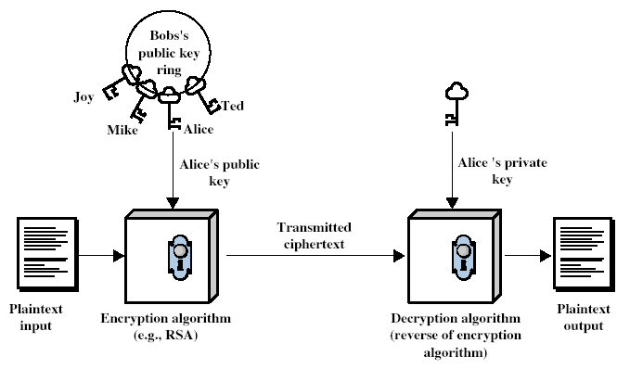
Public-Key Cryptography
Notes:
Stallings Fig 9.1

Slide 49
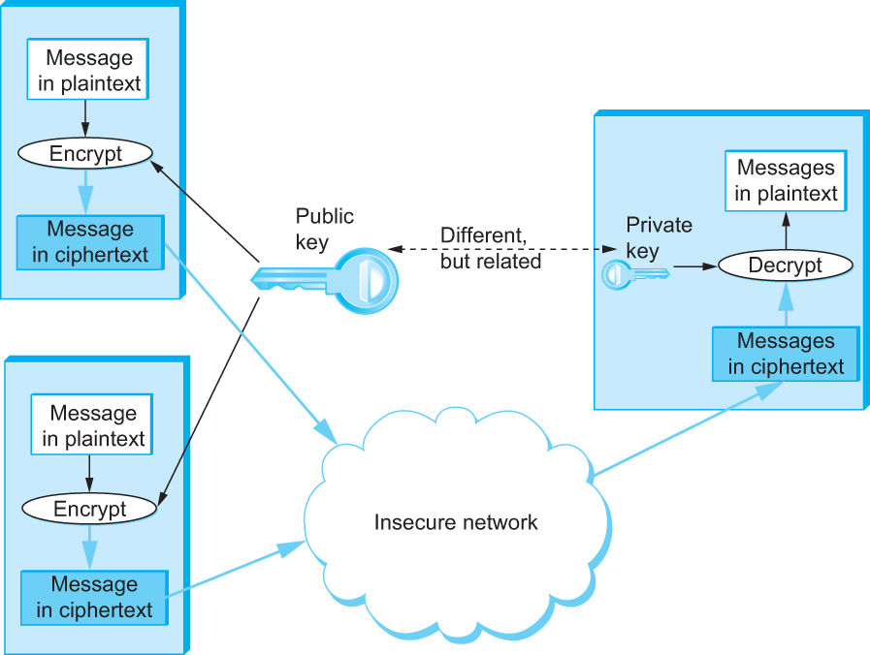
Cryptograhic Building Blocks
Public Key Ciphers
Public-key encryption
Notes:
Depending on whether the encryption is done using the public or the private key the services of privacy or authentication can be provided. If the sender uses their private key and then the recipient's public key then both privacy and authentication are provided.

Slide 50
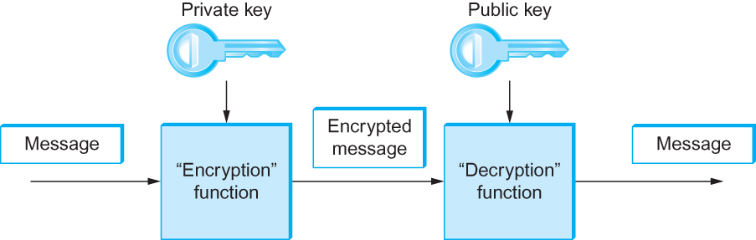
Cryptograhic Building Blocks
Public Key Ciphers
Authentication using public keys
Notes:
Tests of RSA, public key algorithm discussed next, indicate that up to 5000 MIP Years were required. On the issue of speed of use, RSA is still more than two orders of magnitude slower that DES and AES. It makes sense to use RSA to encrypt the keys used to encrypt the actual plaintext and use the block secret key cipher to actually secure the message. This solves much of the key distribution problem encountered in secret key systems.

Slide 51
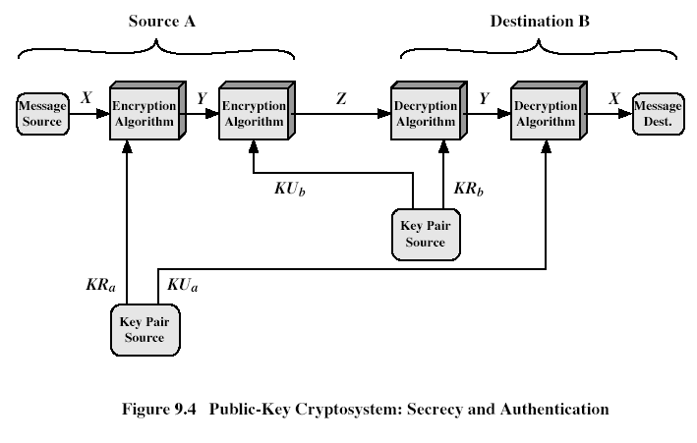
Public-Key Cryptosystems
Notes:
Stallings Fig 9.4
Here see various components of public-key schemes used for both secrecy and authentication. Note that separate key pairs are used for each of these – receiver owns and creates secrecy keys, sender owns and creates authentication keys.

Slide 52
Public-Key Applications
can classify uses into 3 categories:
encryption/decryption (provide secrecy)
digital signatures (provide authentication)
key exchange (of session keys)
some algorithms are suitable for all uses, others are specific to one

Slide 53
Public Key Security
PRIVACY
AUTHENTICATION
INTEGRITY
NON-REPUDIATION
Services
Public Key Technology
Technology
Digital Certificates
Certification Authorities
Infrastructure
Security Management
Public Key Technology Best Suited to Solve Business Needs
Infrastructure = Certification Authorities

Slide 54
Cryptograhic Building Blocks
Public Key Ciphers
The concept of public-key ciphers was first published in 1976 by Diffie and Hellman.
The best-known public-key cipher is RSA, named after its inventors: Rivest, Shamir, and Adleman.
RSA relies on the high computational cost of factoring large numbers.
Another public-key cipher is ElGamal.
Like RSA, it relies on a mathematical problem, the discrete logarithm problem, for which no efficient solution has been found, and requires keys of at least 1024 bits.
Notes:
Three scientists, Rivest, Shamir, and Aldeman, developed this algorithm. The key to the algorithm is that large prime numbers are used to form the two 1024 bit key strings. The factoring of large numbers is computationally difficult. The two keys and the algorithm are used to both encrypt and decrypt the data. The algorithm is such that using the keys in either order (A then B, or B then A) will encrypt and decrypt the message. The strength comes from the fact that having key A and the message encrypted with A doesn’t help. Only having key B and the message encrypted with A will produce the plaintext. (Or the reverse). In use one key is designated public and the other is designated private. If you are in possession of the private key and encrypt using it then anyone with the public key will be able to decrypt the message. The evidence of a successful decryption will be proof that the original message’s author was in possession of the private key. (Authentication) Similarly, if a public key is used to encrypt a message than only the corresponding private key will successfully decrypt the message. (Privacy). In addition to mathematical complexity, which increases computing load, the message must not be longer than the key so messages longer than 1024 bits are separated into blocks and encrypted separately.

Slide 55
RSA
by Rivest, Shamir & Adleman of MIT in 1977
best known & widely used public-key scheme
based on exponentiation in a finite (Galois) field over integers modulo a prime
nb. exponentiation takes O((log n)³) operations (easy)
uses large integers (eg. 1024 bits)
security due to cost of factoring large numbers
nb. factorization takes O(e ^{log n log log n}) operations (hard)
Notes:
RSA is the best known, and by far the most widely used general public key encryption algorithm.

Slide 56
RSA Key Setup
each user generates a public/private key pair by:
selecting two large primes at random - p, q
computing their system modulus N=p.q
note ø(N)=(p-1)(q-1)
selecting at random the encryption key e
where 1<e<ø(N), gcd(e,ø(N))=1
solve following equation to find decryption key d
e.d=1 mod ø(N) and 0≤d≤N
publish their public encryption key: KU={e,N}
keep secret private decryption key: KR={d,p,q}
Notes:
This key setup is done once (rarely) when a user establishes (or replaces) their public key. The exponent e is usually fairly small, just must be relatively prime to ø(N). Need to compute its inverse to find d. It is critically important that the private key KR={d,p,q} is kept secret, since if any part becomes known, the system can be broken. Note that different users will have different moduli N.

Slide 57
RSA Use
to encrypt a message M the sender:
obtains public key of recipient KU={e,N}
computes: C=Me mod N, where 0≤M<N
to decrypt the ciphertext C the owner:
uses their private key KR={d,p,q}
computes: M=C^{d} mod N
note that the message M must be smaller than the modulus N (block if needed)

Slide 58
RSA Example
Select primes: p=17 & q=11
Compute n = pq =17×11=187
Compute ø(n)=(p–1)(q-1)=16×10=160
Select e : gcd(e,160)=1; choose e=7
Determine d: de=1 mod 160 and d < 160 Value is d=23 since 23×7=161= 10×160+1
Publish public key KU={7,187}
Keep secret private key KR={23,17,11}
Notes:
Here walk through example using “trivial” sized numbers.
Selecting primes requires the use of primality tests.
Finding d as inverse of e mod ø(n) requires use of Inverse algorithm (see Ch4)

Slide 59
RSA Example cont
sample RSA encryption/decryption is:
given message M = 88 (nb. 88<187)
encryption:
C = 88⁷ mod 187 = 11
decryption:
M = 11²³ mod 187 = 88
Notes:
Rather than having to laborious repeatedly multiply, can use the "square and multiply" algorithm with modulo reductions to implement all exponentiations quickly and efficiently (see next).

Slide 60
Cryptograhic Building Blocks
Authenticator
An authenticator is a value, to be included in a transmitted message, that can be used to verify simultaneously the authenticity and the data integrity of a message.
One kind of authenticator combines encryption and a cryptographic hash function.
Cryptographic hash algorithms are treated as public knowledge, as with cipher algorithms.
A cryptographic hash function (also known as a cryptographic checksum) is a function that outputs sufficient redundant information about a message to expose any tampering.
Notes:
Both secret key and public key algorithms have overhead and may be overkill for some security functions. Message Digest Algorithms are for use where the integrity of the message is an issue, such as with a contract, but the readability of the plaintext is not. The plaintext is run through the algorithm and the output is a fixed length cryptographic checksum. If the same algorithm is run on the received plaintext then obtaining the same checksum can be taken as proof that the message has not been changed since the digest was calculated. Since this function is a chain operation, each successive block uses the output of the preceding block as the starting point, it is very difficult to reverse the process. That is why this type of algorithm is known as one-way. 512 bit blocks of message and 128 bits of digest are used at a time to create a new digest. Message Digest 5 (MD5 and Secure Hash Algorithm 1(SHA-1) are commonly used one way hashing algorithms. Since there recently has been research indicating MD5 may not be as secure as SHA-1 this is the currently preferred hashing algorithm. NIST has proposed the SHA-2 be used for new applications and that SHA-1 be phased out by 2010.
.

Slide 61
Cryptograhic Building Blocks
Authenticator
Just as a checksum or CRC exposes bit errors introduced by noisy links, a cryptographic checksum is designed to expose deliberate corruption of messages by an adversary.
The value it outputs is called a message digest and, like an ordinary checksum, is appended to the message.
All the message digests produced by a given hash have the same number of bits regardless of the length of the original message.
Since the space of possible input messages is larger than the space of possible message digests, there will be different input messages that produce the same message digest, like collisions in a hash table.
Notes:
In cases where only the integrity of the message is important, not the secrecy of the content, not all of the message must be encrypted. A message may carry a ‘digital signature’ to prove the source. The signer uses it’s private key to encrypt the signature. The receiver uses the public key to decrypt the signature. If the decryption is successful the assumption is that the purported owner of the private key signed the document. With Keyed MD5 a secret key k is added to the message before the one-way cipher is used on it. The key is agreed on by one of the previously discussed handshake methods. Thus the residue of the MD5 cipher will be different than that of the message alone. The message, and the MD5 checksum is sent to the receiver. The receiver adds the secret key to the message and runs the MD5 algorithm on it. If the checksums now agree the message integrity is verified. If RSA is available a random string k can be used at the sender and the string k is encrypted with the sender’s private key. The receiver decrypts k using the sender’s public key and adds it to the message for the MD5 operation.
With MD5 with RSA the one way cipher is used on the document and the residue is encrypted using the private key. The recipient runs the MD5 to get the residue, then decrypts the trailer using the secret key. The agreement of the residues proves both the identity of the sender and the integrity of the document as arriving without changes.

